Slide 1


University Student Council
Please Check in:
Georgia College & State University’s
Student Government Association
Agenda
Notes:
Good afternoon, thank you all for coming
, my name is…
One of the senators and also the PPT of the senate…

Slide 2

Welcome!
Thank you for attending our annual University Student Council!

Slide 3
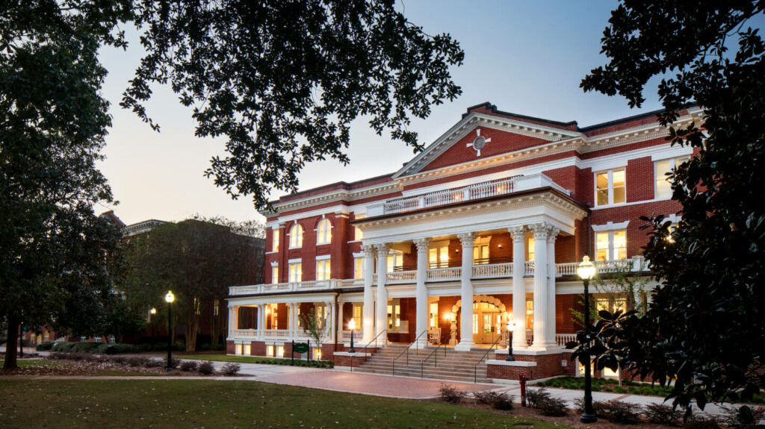
Agenda
Meet & Greet
Welcome
Introduction to 2024-25 Executive Officers
Report from President Hawkins, Vice President Kelly, PPT Wright
Bill and Resolution Processes
How can we help your organization?
Q&A

Slide 4

Executive Office 2024-2025
President Axel Hawkins
Vice President Leah Kelly
PPT Will Wright
Secretary Charlotte Middlebrooks
Treasurer Serena Myrvold
Attorney General Ezra Ryall
Chief of Staff Liam Landry
Notes:
Include necessary Exec Reports here (Cabinet openings, along with Pr. Hawkins, VP Kelly, and PPT Wright)

Slide 5

How We Can Help You:
Bills
Resolutions
Student Travel Fund
Advice

Slide 6
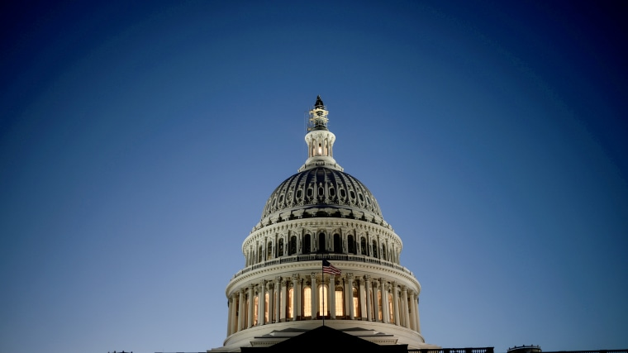
Bills
Bill Process
Contact Senator
Senator crafts Bill
Sent through Appropriations, Senate, and to Administration
See Example
Notes:
Covered tshirts and meeting expenses.
For tshirts, we do require you to table with the tshirts purchased with SGA funds, because funds are mostly used to benefit the student body as a whole, so
Examples like international fest; but we encourage you to still reach out bc we do still do funding outside of this.
Again bills are given preference and are favorable when they benefit the student body as a whole

Slide 7
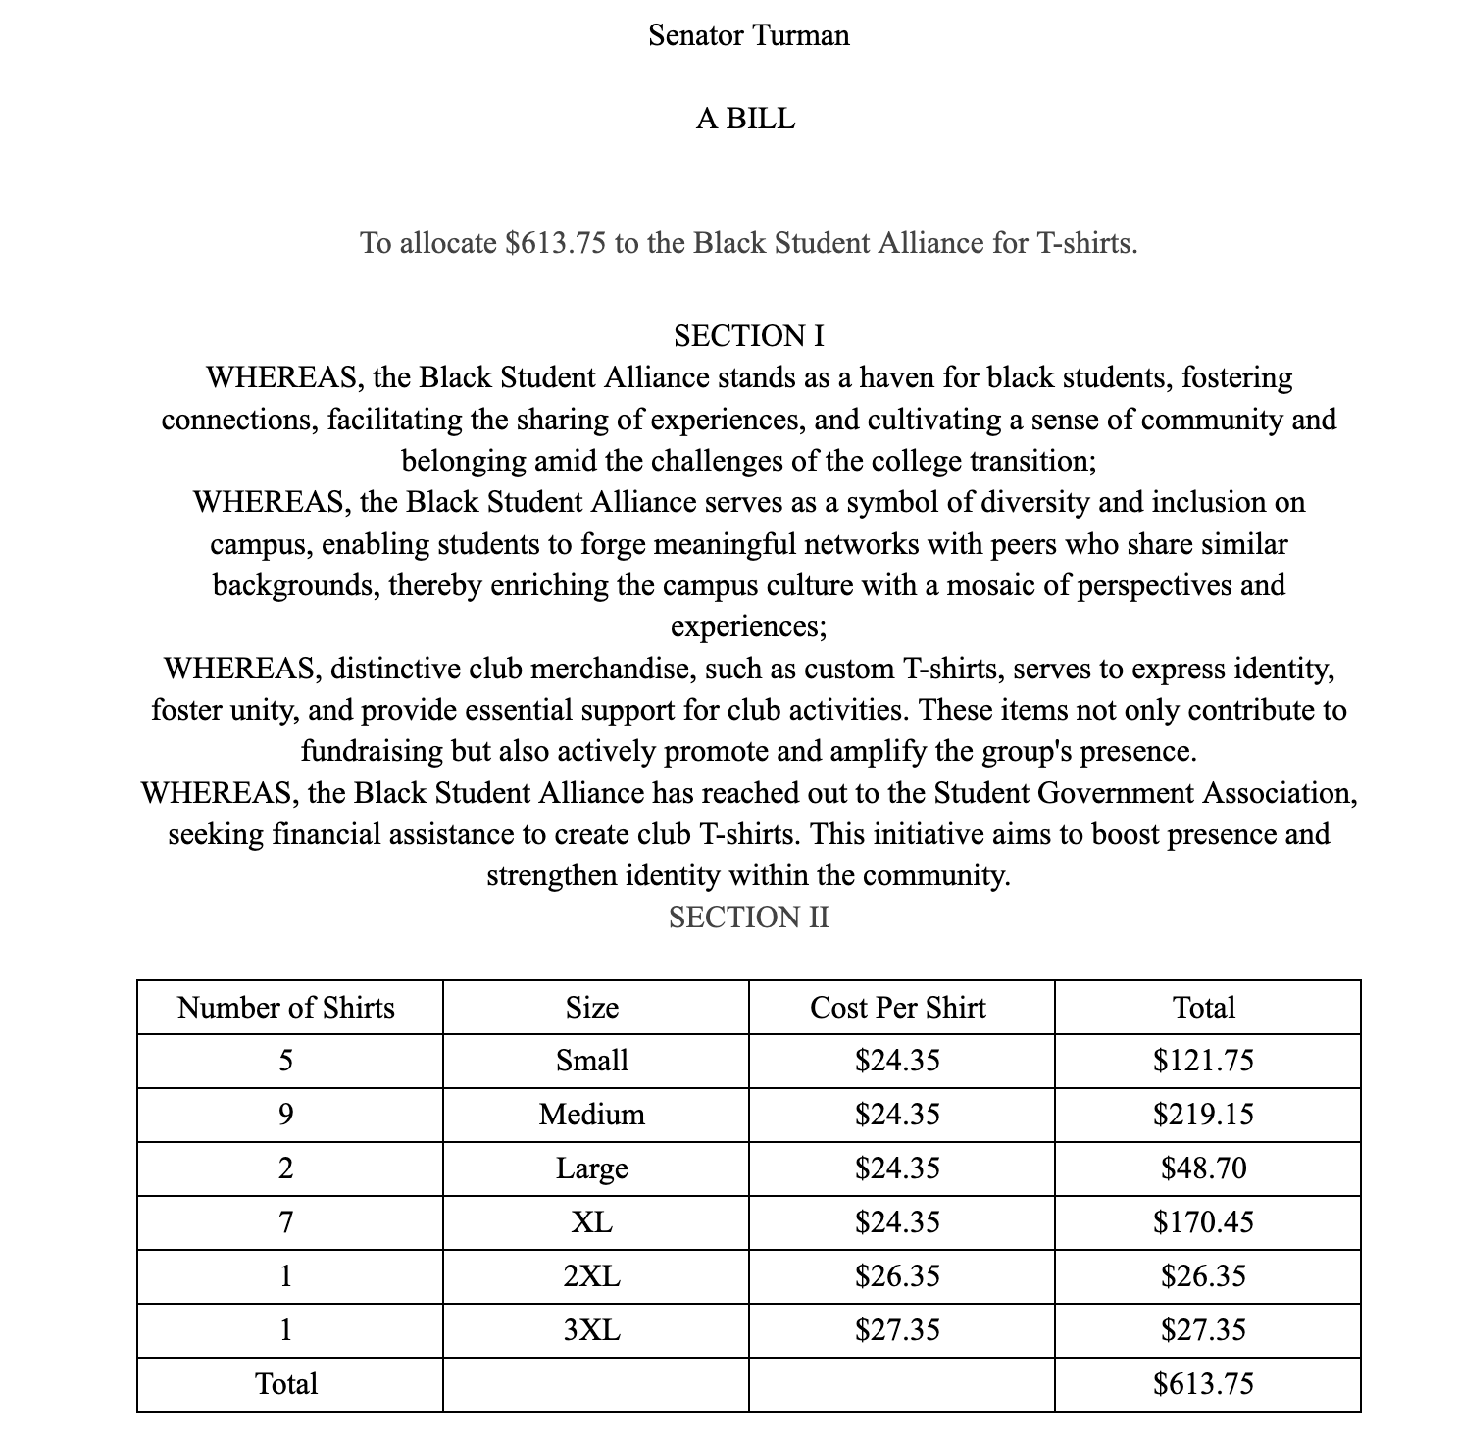

Example Bill

Slide 8
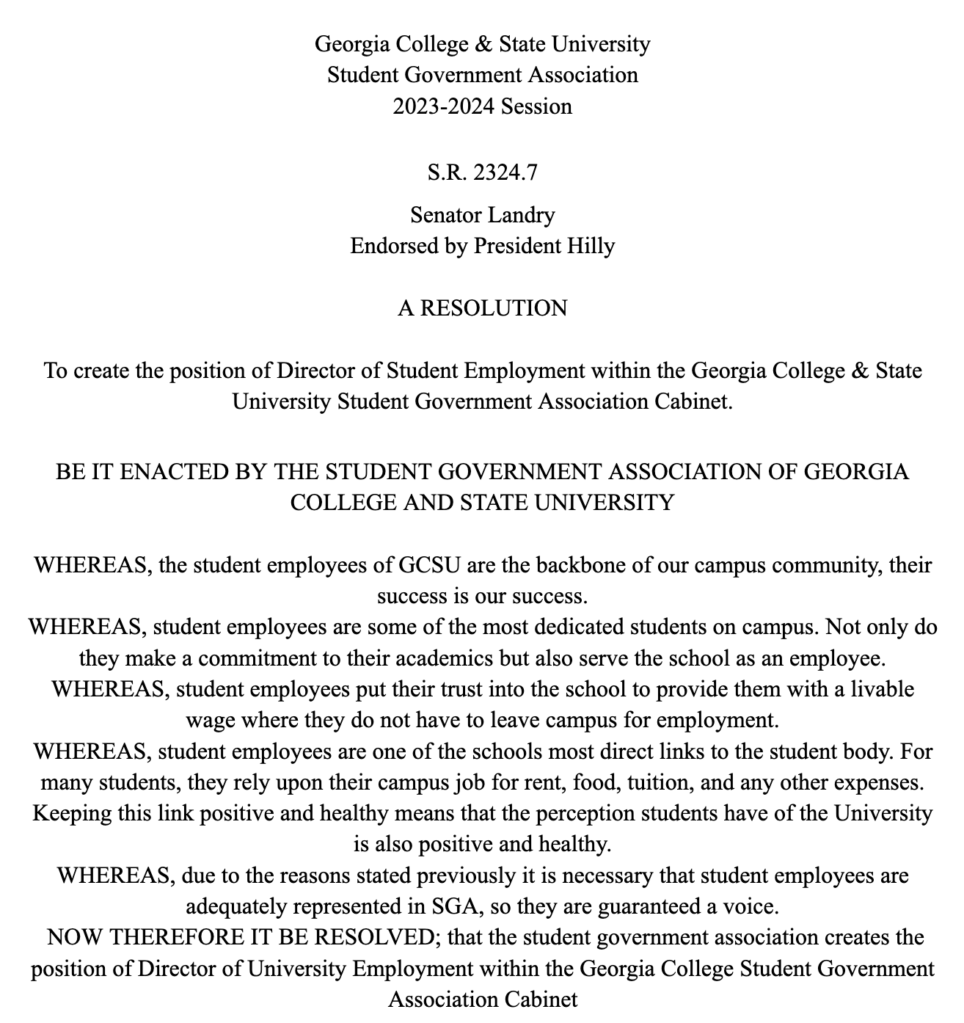
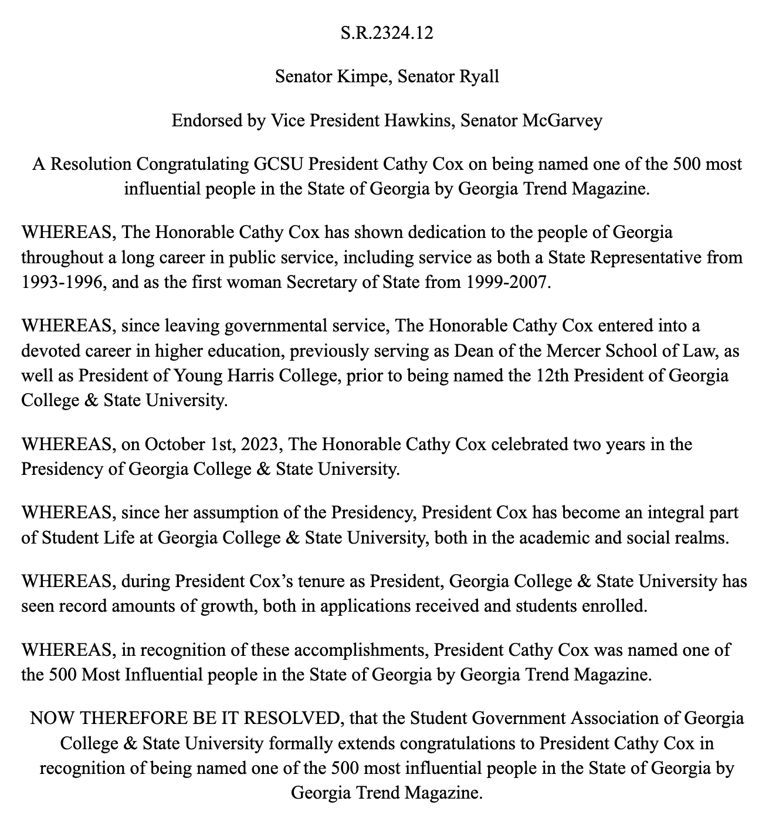
Resolutions
Notes:
Great way to make any change, big or small on campus, Senators are assigned committees that write and work with administrations on any issues that effect the student body. President Hawkins also meets with President Cox during the semester and discusses these issues.

Slide 9
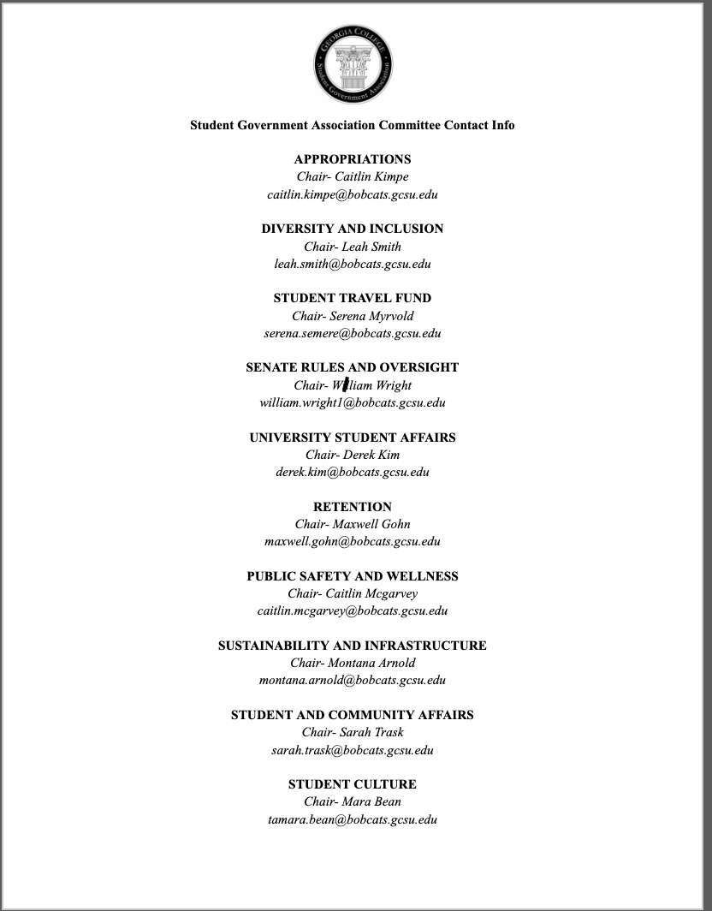
Committee Chairs
Notes:
Contact info for the Committees that deal with a wide variety of issues, also included in check in form (the check in form will also be on the last slide)

Slide 10

Student Travel Fund
Questions:
serena.semere@bobcats.gcsu.edu
Notes:
Serena- for education conferences, separate from MURACE, must receive full requirements for reimbursement.

Slide 11
Advice
Notes:
President Hawkins and any other exec member

Slide 12
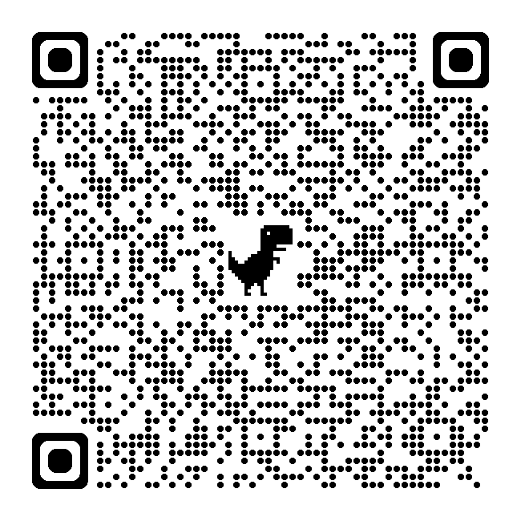
SGA Archive see guidelines, past bills, resolutions and more (also available on our website) gcsu.edu/sga

Slide 13

Q&A Session

Slide 14
THANK YOU FOR COMING!
(don’t forget to check in)

Slide 15
University Student Council
Georgia College & State University’s
Student Government Association

